Slide 1

S O U T H L A K E H O M E E D U C A T O R S
Lesson 11
Core Mechanics V: Wave After Wave
Semester 1, Week 11 - Level 2 Complete Milestone

Slide 2
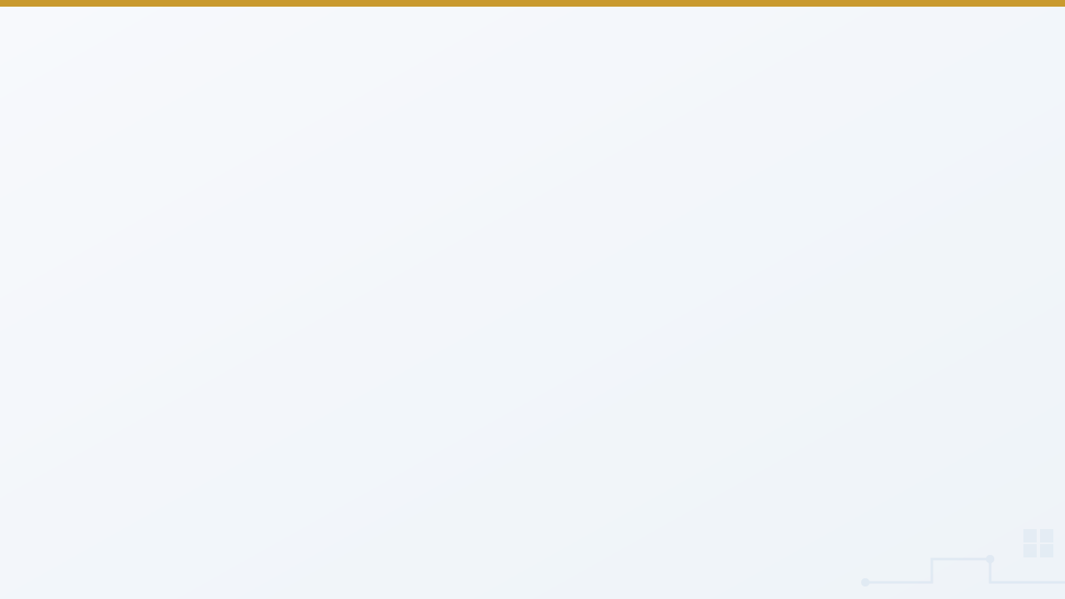

At a Glance
Lesson 11 objectives & materials
By the end of today, students will:
What We're Using Today
Nest a second decision inside an existing win-check
•
Demo laptop with the four active engines verified
Reuse spawn_enemies from a third caller: the game itself
•
Unity (C#), for the live lecture demo
Keep new state (wave) on the GameManager - and reset it
•
No new assets this week - reuses the spawn routine from Lesson 10
Explain what the Level 2 Complete milestone means
•
This is a milestone lesson - Level 2 Complete!
•
Your own [YourName]Game project from Lesson 10 - not a new one
IGDA framework tie-in: Programming - state machines, code reuse/refactoring, game balance and pacing (intermediate).
VIDEO GAME CREATION
Lesson 11
2

Slide 3

Today's Agenda
0:00 - 0:05
Welcome back, Lesson 10 recap (game state, the Stalemate)
0:05 - 0:20
One More Question: Is This the Last Wave?
0:20 - 0:40
The Same Spawn Code, Called a Third Way
0:40 - 0:50
Milestone Moment: What "Level 2 Complete" Actually Means
0:50 - 0:55
Introduce lab exercise, hand out engine-specific handouts
LAB TIME
— Wave After Wave —
0:55 - 1:50
Build multiple waves, reaching the milestone
1:50 - 2:00
Exit check: milestone celebration share-out
VIDEO GAME CREATION
Lesson 11
3

Slide 4

Welcome Back
Lesson 10 recap - your game got genuinely replayable.
5 min
VIDEO GAME CREATION
Lesson 11
4

Slide 5

Welcome Back
5 min
Quick recap of Lesson 10:
A game_active flag that freezes gameplay, and one reset routine run by R
Game state: everything that changed must be put back on restart
The Stalemate: last week's Level 3 bug - still in your game, on purpose
Today: clearing one wave becomes clearing several before you truly win
Open your own project from last week today, not a new one - and no new assets needed either, everything builds on the spawn routine you already have.
VIDEO GAME CREATION
Lesson 11
5
Notes:
"Welcome back! Last week your game became genuinely replayable - a real freeze, a real restart. Quick show of hands - who tested a full win-then-restart AND a full lose-then-restart?" [Pause, call on 1-2 volunteers]
"Two things from last week I want you to carry into today. First, game state: when you restart, EVERYTHING that changed has to be put back, including anything extra you added. Second, the bug. Some of you found a round that simply never ends - you destroyed some enemies, let the others escape, and nothing happened: no win, no loss, and R did nothing. Let's give it a name: the Stalemate. Hold that thought. It's still in your game, on purpose, and today it's about to get more interesting." [Do NOT explain the fix. If a student asks, say: 'What has to be true for a round to be over?']
"Today's a big one - by the end of class, your game reaches its second major milestone of the year. Clearing one wave of enemies is about to become clearing several, in a row, before you actually win."

Slide 6

One More Question
Is this actually the last wave?
15 min
VIDEO GAME CREATION
Lesson 11
6

Slide 7


Nesting a Decision
15 min
Since Lesson 6: are all enemies gone? Today, a second part: gone, AND is this the last wave? Both true -> real win. Otherwise -> the round continues.
The first time this course nests one decision inside another - a small code change, a genuinely new shape of thinking.
Discussion: can you think of a real-life decision where the answer to one question depends on a second question nested inside it? ("Can I go to the party" depends on "is my homework done," which might depend on "do I understand the assignment.")
VIDEO GAME CREATION
Lesson 11
7
Notes:
"Since Lesson 6, your win-check has asked exactly one question: are all the enemies gone? Today, that question grows a second part: gone, AND is this the last wave? If both are true, you really win. If enemies are gone but more waves remain, the round just... continues."
"This is the first time this course asks you to nest one decision inside another. It's a small change in code, but it's a genuinely new shape of thinking - a decision whose answer depends on a second, smaller decision."
[Discussion question] "Can anyone think of a decision in real life that works this way - where the answer to one question depends on a second question nested inside it?" (Examples to draw out if needed: "can I go to the party" depends on "is my homework done," which itself might depend on "do I understand the assignment.")
[Timing checkpoint: wrap by 0:15]

Slide 8
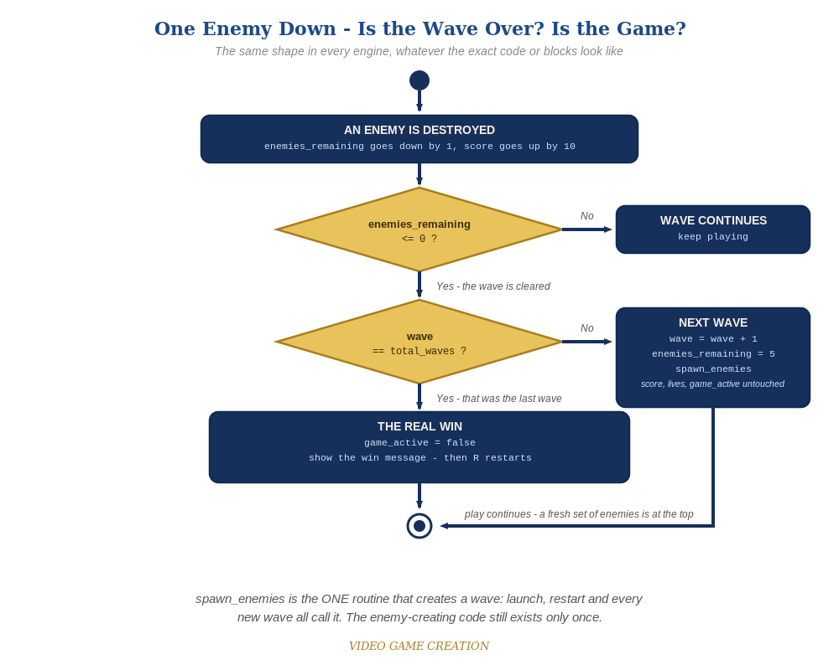
The Whole Decision, One Picture
Two questions, in order
Is the wave cleared? No: carry on.
Was it the last wave? Yes: the real win.
No: wave + 1, enemies_remaining = 5, spawn_enemies.
Score, lives and game_active are untouched between waves.
VIDEO GAME CREATION
Lesson 11
8
Notes:
[Show the next slide: the Activity Diagram] "Here's the whole decision in one picture. An enemy is destroyed: enemies_remaining goes down by one. Is it zero? If not, the wave simply continues. If it is, the wave is cleared - and now the second question: is this the last wave? Yes: the real win, and R restarts as before. No: the next wave. wave goes up by one, enemies_remaining goes back to five, and we call spawn_enemies again. Notice score, lives and game_active are untouched. This is the same picture in every engine, whatever the code looks like."
[Timing checkpoint: wrap by 0:20]

Slide 9

A Third Door In
The same enemy-spawning code, one more way to call it.
20 min
VIDEO GAME CREATION
Lesson 11
9

Slide 10

Three Doors, One Room
20 min
No new enemy-spawning code today. You've had it since Lesson 5. Lesson 10 made it callable a second way, for restarts. Today: a THIRD way, every wave clear.
Unity demo: SpawnEnemies() already has two callers (Start() and ResetGame()). RegisterKill() is static, so it can't use the Spawner slot - it raises nextWaveRequested, and GameManager's Update() spawns the wave.
Same enemy-creation code. Three doors in: the very first game, every restart, and now every wave clear. That's the whole idea.
VIDEO GAME CREATION
Lesson 11
10
Notes:
"Here's the good news: you're not writing new enemy-spawning code today. You've had it since Lesson 5, and Lesson 10 already made it callable a second way, for restarts. Today it gets a THIRD way to run: every time a wave is cleared, if more waves remain."
[Demo cue: switch to Unity, open last week's project and GameManager.cs]
"Watch. SpawnEnemies() on EnemySpawner already has two callers: Start() and ResetGame(). Today I add three static fields to GameManager: wave, totalWaves and nextWaveRequested. Then I turn RegisterKill()'s win check into an if/else: if wave is at least totalWaves, hasWon and gameActive, exactly as before. Otherwise wave++, enemiesRemaining back to 5, and nextWaveRequested = true." [Build the if/else live]
"Why a flag, and not just spawner.SpawnEnemies() right there? Try it." [Type spawner.SpawnEnemies() inside RegisterKill() and let the compiler complain] "RegisterKill() is static - it belongs to the GameManager class, not to the one GameManager object in the scene, and the Spawner slot we filled in last week belongs to that object. A static method can't see it. So RegisterKill() leaves a note, and GameManager's own Update(), which does belong to the object, checks the note, clears it and calls spawner.SpawnEnemies()." [Add the nextWaveRequested check to Update()] "That's the real cost of static members. We'll come back to it in Semester 2."
[Demo cue: add public Text waveText to HUD.cs, one line in Update(), drag WaveText onto the slot in the Inspector, press Play and clear wave 1 into wave 2]
"Same enemy-creation method, zero changes to it. Three callers in: EnemySpawner's Start(), every restart through ResetGame(), and now every wave clear through GameManager's Update(). That's the whole idea."
[Timing checkpoint: wrap by 0:35]

Slide 11
New State, Same Habit
wave and total_waves are game state too - and they live on the GameManager.
Does restart reset it?
Who owns it?
wave must go back to 1 in the one reset routine - test it from wave 3
The GameManager. Objects report; the manager counts and decides
Anything extra?
Same two questions
A wave message, an effect, a sound - what changes it, and what puts it back?
What changed when the round or wave ended? What changes it back?
Test it: reach wave 3, lose, press R. The HUD must say Wave 1.
VIDEO GAME CREATION
Lesson 11
11
Notes:
[Show the next slide: New State, Same Habit] "Last week's habit applies the moment you add anything new. wave and totalWaves are new game state, and they live on the GameManager, just like score and lives, because more than one object cares about them. So: does the restart put wave back to 1? I'll check it right now." [Demo cue: in the Unity demo, reach wave 3, lose, press R, and point at the HUD: it must say Wave: 1. If you forgot ResetGame()'s wave = 1, you will see Wave: 3 - leave that on screen for a moment before fixing it.]
"And if you add a wave message today, an effect, a sound, anything: ask the same two questions. What does it change when the round ends or the wave changes? And what puts it back?"
[Timing checkpoint: wrap by 0:40]

Slide 12

Milestone Moment
What finishing Level 2 Complete actually means.
10 min
VIDEO GAME CREATION
Lesson 11
12

Slide 13
Level 2 Complete
10 min
Once multiple waves work today, your game can:
Move & shoot
Face multiple waves
Track score
Survive with lives
Restart cleanly
Truly win or lose
Level 1 MVP meant a complete, playable loop. Level 2 Complete means real depth - failure that matters, progress that builds, escalation as more waves arrive. This is the kind of thing that starts to feel like an actual arcade game, not just a working prototype.
From here through Lesson 15: sound, animation, difficulty, and polish. The mechanics are done - what's left is making them sing.
VIDEO GAME CREATION
Lesson 11
13
Notes:
"Take a second to think about everything your game can do now: move, shoot, face a wave of enemies, track a score, survive with limited lives, restart cleanly - and now, face MULTIPLE waves before really winning. That's not a small list. That's the Level 2 Complete milestone from your capstone's design document."
"Back in Lesson 6, Level 1 MVP meant 'a complete, playable loop, start to finish.' Level 2 Complete means something more: a game with actual depth - failure that matters, progress that builds, and a real sense of escalation as more waves arrive. This is the kind of thing that starts to feel like an actual arcade game, not just a working prototype."
"From here through Lesson 15, everything is about making this same loop feel good - sound, animation, difficulty, and polish. The mechanics are done. What's left is making them sing."
[Timing checkpoint: wrap by 0:50]

Slide 14

Today's Exercise & Lab
Wave After Wave - building your second milestone.
5 min
VIDEO GAME CREATION
Lesson 11
14

Slide 15
Wave After Wave
5 min
Clearing a wave spawns a fresh one, up to 3 total. Clearing wave 3 is the real win - built on top of your existing project.
Level 1 - Minimal
Level 2 - Complete
Level 3 - Refined
Clearing a wave spawns a new one, up to 3; wave shown on screen.
Seamless, correct transitions every time; restart returns to wave 1.
Fix the Stalemate so it works with waves; a brief wave announcement; tighter reuse.
MVP - a complete finish for today.
Everything works end to end.
Ready to share.
Test a FULL 3-wave playthrough today, not just wave 1 - and confirm losing a life mid-wave still works correctly no matter which wave you're on.
VIDEO GAME CREATION
Lesson 11
15
Notes:
"For lab today, open your own project from last week - not a new one, and no new assets needed. Today's goal: clearing a wave spawns a new one, up to 3, and only clearing wave 3 is a real win."
[Hand out engine-specific handouts]
"Test a FULL 3-wave playthrough today, not just wave 1 - and separately, make sure losing your last life mid-wave still works correctly, whichever wave you're on."
"One more thing. The Stalemate is still in there, and now it can freeze the game at any of the three waves. If it starts to annoy you, that's your Level 3. You already know how to find it."
"Questions before we start lab? ... Let's build your second milestone."

Slide 16
Lab Time Notes
Most common bug: forgetting the wave-count check, so clearing wave 1 immediately shows the win message. Test this explicitly.
Second most common: the wave-advance branch accidentally touching score or lives - only enemies_remaining and wave should change.
Game-state drift: test restarting from mid-wave-2 or mid-wave-3 - restart should always return to wave 1.
The Stalemate: confirm it is real, name it, don't hand over the fix. Level 3 is where it gets solved.
At 1:50, do a real celebration share-out - this is the Level 2 Complete milestone. Consider 2-3 students demoing a full 3-wave playthrough.
VIDEO GAME CREATION
Lesson 11
16
Notes:
- The single most common bug this week: forgetting the wave-count check entirely, so clearing wave 1 immediately shows the win message. Test this explicitly - the win should NOT appear until the final wave.
- Second most common: the wave-advance branch accidentally touching score or lives - only enemies_remaining and the wave counter should change between waves.
- Game-state drift: wave not reset on restart. Have students test restarting from mid-wave-2 or mid-wave-3, not just from a fresh game - restart should always return to wave 1. Point them back to the 'Check Your Game State' list in the Handout.
- The Stalemate: students will start reporting 'my wave never ends.' Confirm it is real, name it, do not hand over the fix, and send them back to their Lesson 10 Level 3 notes. Students who already fixed it should check that the fix works at every wave. Each Key's Level 3 section has the worked fix.
- Engine notes: Godot spawns the next wave with call_deferred (a wave clears mid-collision); Unity requests the next wave with a flag that GameManager's Update() acts on; Scratch broadcasts [spawn enemies]; GameMaker calls spawn_enemies(), with a Function Call block in Visual. A doubled wave in Scratch usually means a spawn script is still on [start game].
- Circulate by engine cluster as usual. At 1:50, call time and do a real celebration share-out - this is the Level 2 Complete milestone. Consider having 2-3 students demo a full 3-wave playthrough from start to finish, the same energy as Lesson 6's milestone share-out.

Slide 17

Level 2 Complete!
Multiple waves, real stakes, a clean restart - a genuine arcade game, not just a working prototype.
Next week: sound effects - shoot, explosion, game over, wave clear. The polish begins.
Keep playtesting your full 3-wave run at home if you'd like - try a Level 3 idea if you haven't already.
VIDEO GAME CREATION
Lesson 11
17

